Slide 1

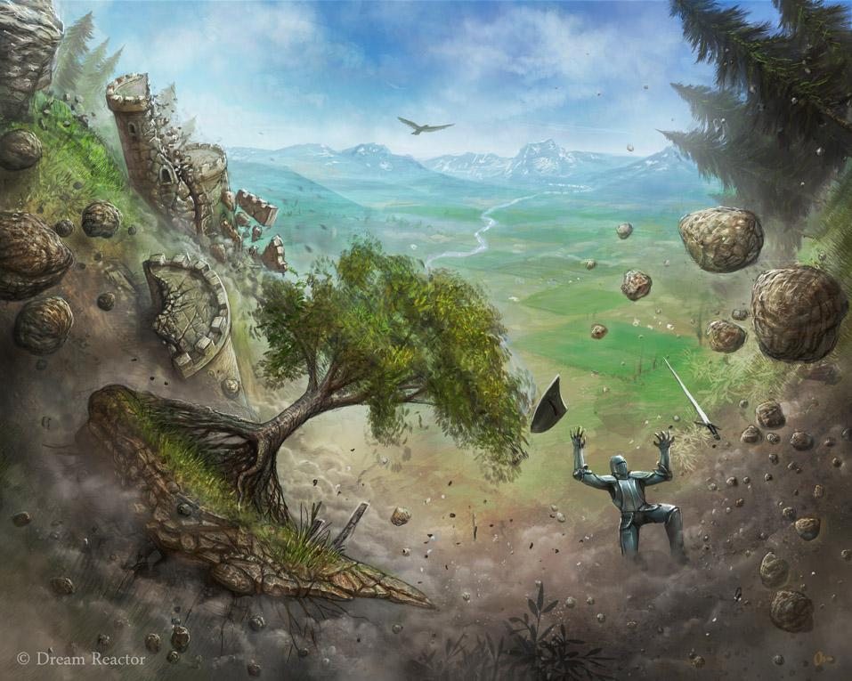
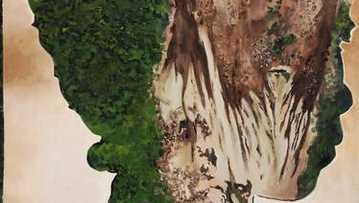

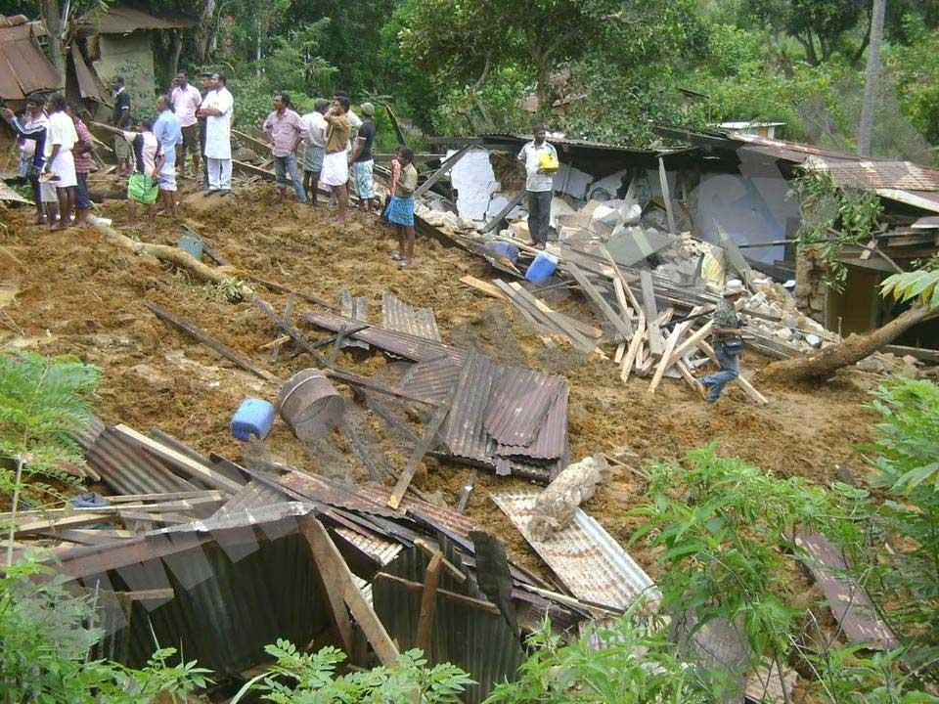
Siren: Landslide Threat Alert Application
IDENTIFYING RISK WITH SCIENCE + COMMUNITIES
Project by Team Cifra

Slide 2
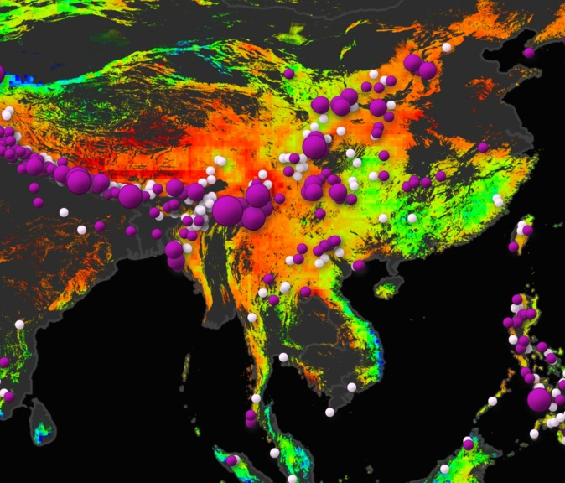
The Challenge
IDENTIFYING RISK WITH SCIENCE + COMMUNITIES
To develop a tool that uses data from NASA satellites and ground-based sources to determine the risk of landslides in rural communities and share the results with local communities and governments.

Slide 3
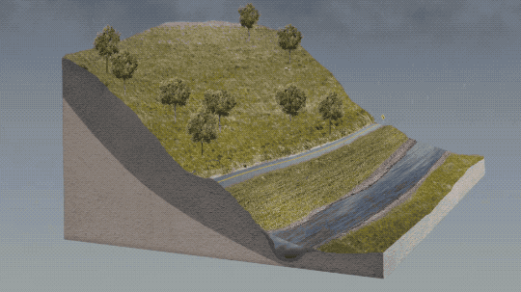
What is a Landslide?
According to UNESCO landslide is a movement of a mass of rock, or earth down a slope under the influence of gravity (WP/ WLI - International Geotechnical Societies’ UNESCO Working Party on World Landslide Inventory 1990).
How does it happen?
Due to reasons like heavy rainfall, natural causes, human activities the upper mass of the soil gets dislocated from the layers and travels down a slope.

Slide 4
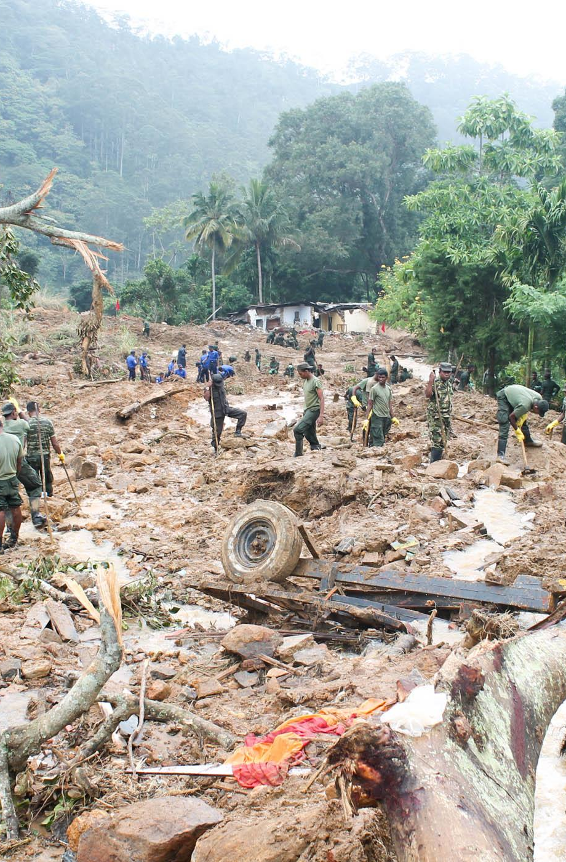
Why?
The heavy rains caused flooding and landslides impacting 13 districts in Sri Lanka.
Approximately 20,000 km2 (30.7%) of the acreage of Sri Lanka is highly at risk of landslides.
According to the Disaster Management Centre’s (DMC) situation report as of 23 December 2019,
a total of 65,316 people (19,072 families) were affected
62 houses fully damaged and 1,463 houses partially damaged.
17,776 people (5,277 families) were evacuated to 133 safe locations.
(Sri Lanka: Floods and Landslides - IFRC)
29 October 2014, a landslide struck the Sri Lanka district of Badulla, killing at least 16 people and leaving an estimated 200 missing.
List goes on…..
This app will save lives!!!

Slide 5
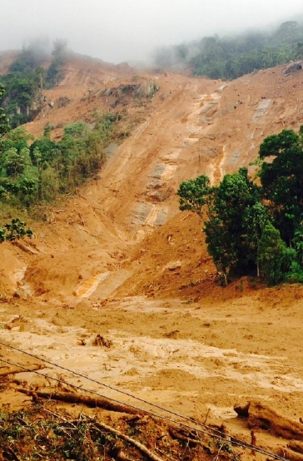
Objectives
To develop an awareness of the community about the threat level they are in
To develop a Landslide Susceptibility Map using WoE models
To provide an improved decision support tool for hazard managers and planners
to incorporate Earth observations (as satellite data) with local open data provided by national entities and scientific institutes.
Motivate the general public can contribute by capturing data in their territories to improve the precision of the analysis.

Slide 6
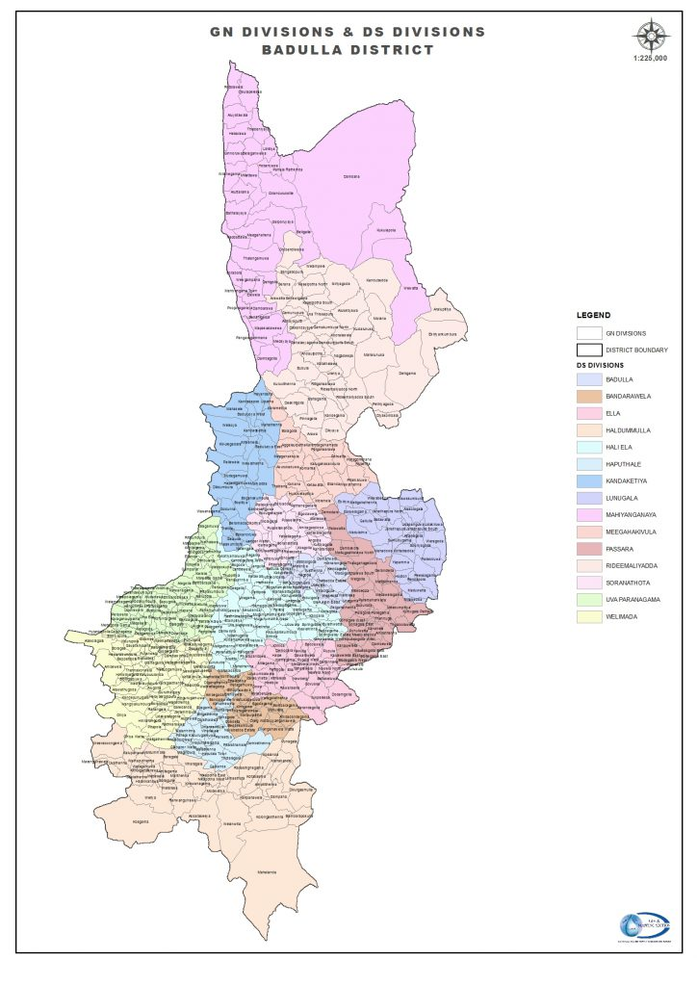
Study Area
The study was focused on landslide susceptibility mapping in Badulla District, which is situated in the Uva province between 6º 59’ 05” of North latitude and 81º 03’ 23” of the East longitude of Sri Lanka, using causative factors and application of WoE models. The district covers about 2871 sq. km of land area with altitudes varying from 50 to 2530 m above sea level.
Most of the land area is mountainous, with the growth of population, there is an increasing demand for the lands and utilization of land. Most of the landslide incidents occur due to heavy rainfall.
There is great variation in the rainfall amounts with maximum rainfall occurring during the fall of the year with the heaviest rainfall occurring during the months of October and November.

Slide 7
Questionnaire(Sample of 60)

Slide 8
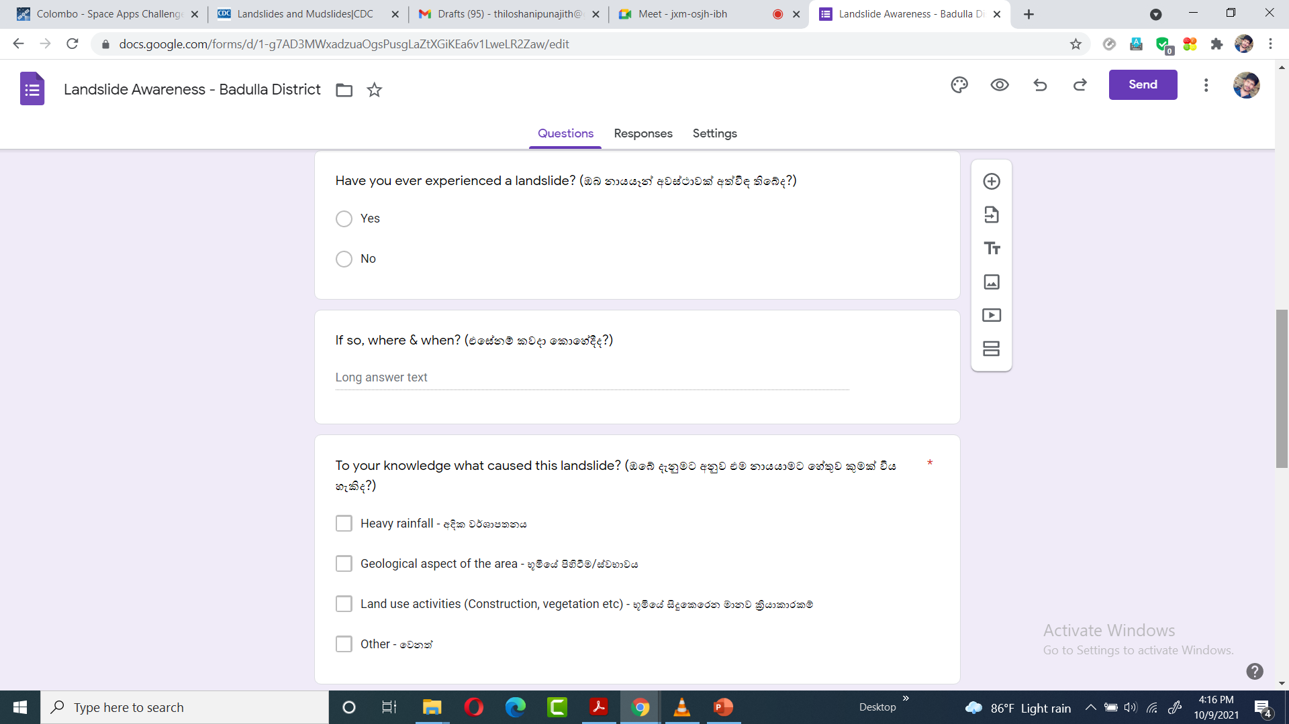

Questionnaire

Slide 9
Here we focused on two main sectors.
Rainfall at the moment.
Here we consider rainfall condition data and duration of rainfall. Then, calculate occurrence probability of landslide because of rainfall(Using machine learning model)
Conditions of the land.
Here we considered whether the landslides causative factors related to surface. And, checked whether those factors met the relevant condition to cause a landslide by the use of susceptibility map(WoE model)
Using conditional probability of above sectors, we predict the final risk.

Slide 10
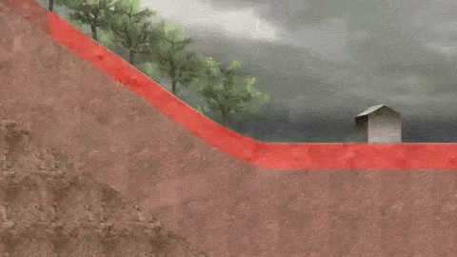
Factors We Considered
Slope data
Curvature data
Distance to stream data
Lithological data
Rainfall data
Land use data

Slide 11
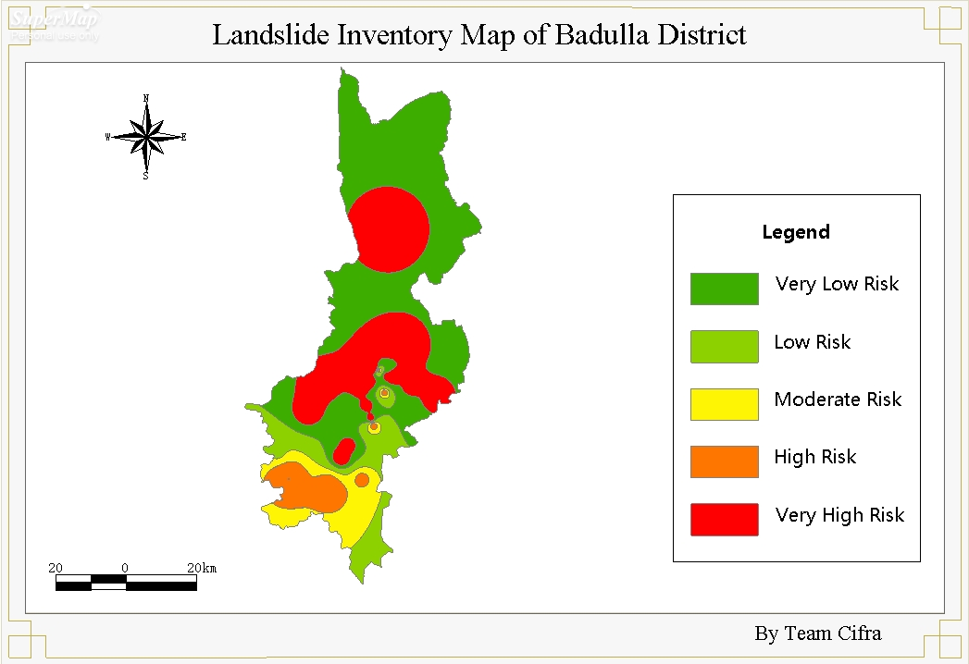
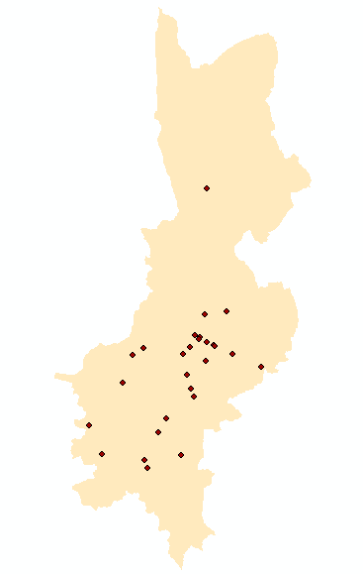
Landslide Inventory Map
Data source: NASA Map & App Gallery - Global Inventory Map

Slide 12
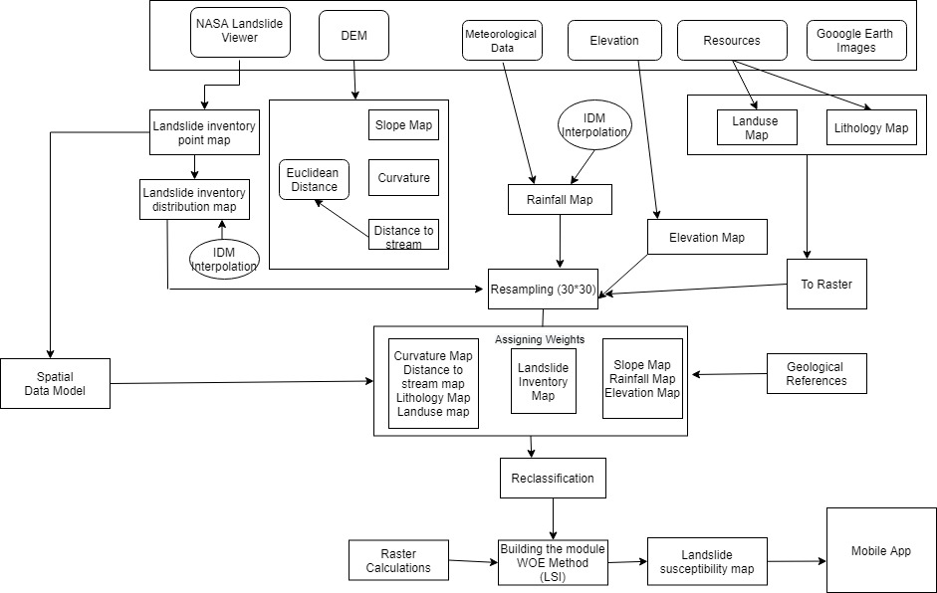
Methodology(Landslide Susceptibility Map)
IDW Interpolation
IDW Interpolation
Spatial Data Modelling Tool

Slide 13
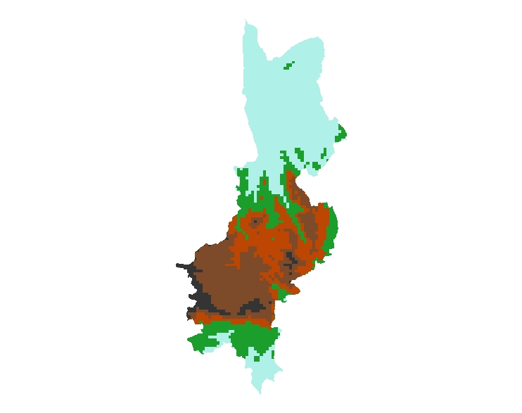
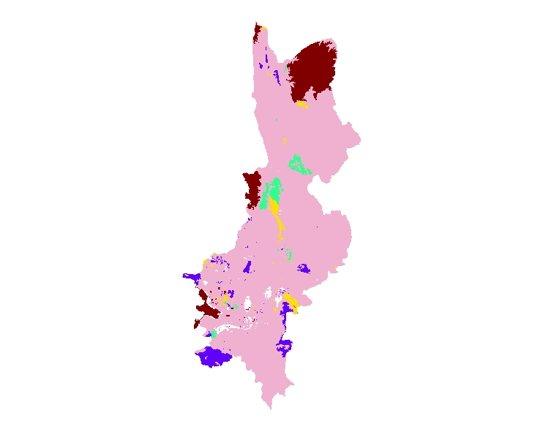
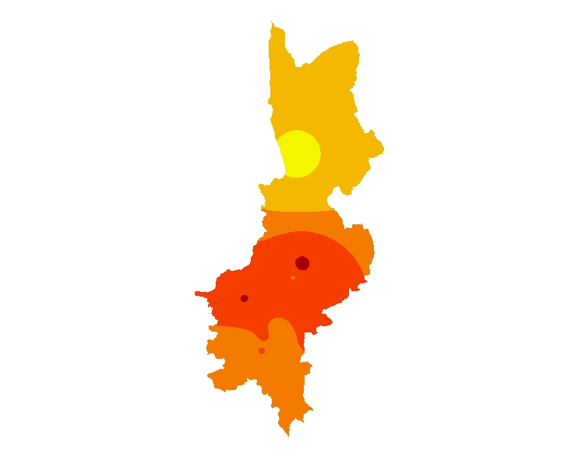
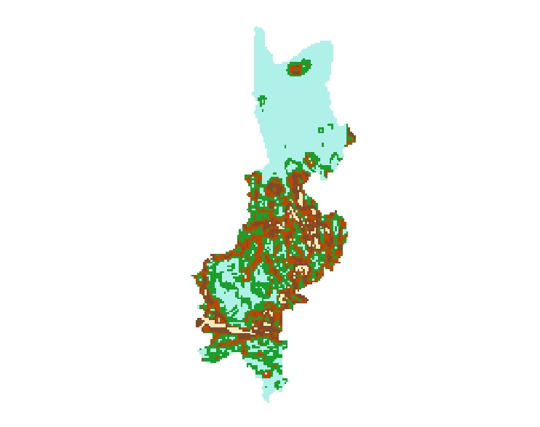
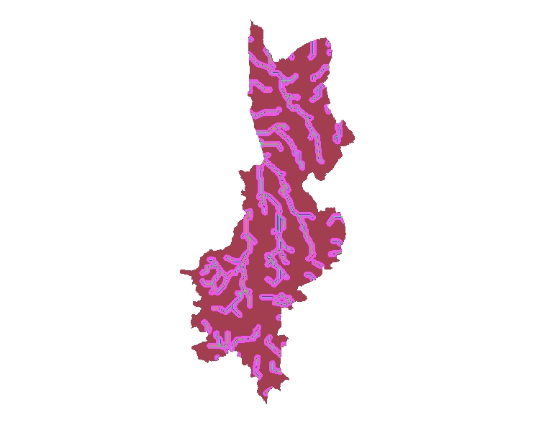
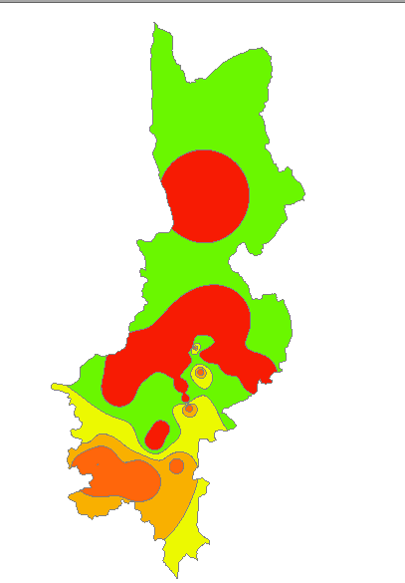

Landslide Causative Factors Reclassification
Each factor map was divided in to certain weight classes.
1
2
Slope
Range(degrees) | Values
0.0 to 2.3 | 1
2.3 to 5.6 | 2
5.6 to 9.3 | 3
9.3 to 15.2 | 4
15.2 to 90 | 5
Rainfall Map
Range(mm) | Values
0.0 to 72.9 | 1
72.9 to 90.1 | 2
90.1 to 95.9 | 3
95.9 to 100.1 | 4
100.1 to 150.7 | 5
3
4
5

Slide 14
Landuse Map
Feature | Values
Urban Lands | 1
Forest Lands | 2
Rangelands | 3
Barren Lands | 4
Agriculture | 5
Distance to stream Map
Range(meters) | Values
150 to 200 | 1
100 to 150 | 2
50 to 100 | 3
0 to 50 | 4
More than 200 | 5
Inventory Map
Type | Values
Very Low Risk | 1
Low Risk | 2
Moderate Risk | 3
High Risk | 4
Very High Risk | 5
Lithology Map
Range(mm) | Values
Weathered tuff | 1
Rhyolite/trachyte | 2
Residual | 3
Colluvial | 4
Alluvial | 5
Curvature Map
Type | Values
Flat | 1
Convex | 2
Concave | 3

Slide 15
Weight of Evidence
The weights for each factors desired based on experts opinion. According to the level influence to land slide occurrence the value of weight vary.
Factor(X) | Resource | Weights(W)
Landslide Inventory | NASA Landslide Viewer | 20
Rainfall | Climate Data Org | 25
Slope | DEM | 15
Curvature | DEM | 7
Lithology | ORR & Associate | 8
Distance to Stream | DEM | 10
Land Use | Google Earth | 5

Slide 16
Risk Map Module
LAND SLIDE SUSCEPTIBILITY INDEX (LSI)
LSI= ((w1*x1)+(w2*x2)+(w3*x3)+(w4*x4)+(w5*x5)+(w6*x6)+(w7*x7))
7
W1,W2,W3,W4,W5,W6,W7 are the weights of the factors
X1,X2,X3,X4,X5,X6,X7 are the categories of the factors
7 is the number of factors
LSI map was reclassified into four susceptibility categories to prepare the landslide susceptibility map of the study area as follows,
16 to 24 value range is as Very low risk area
24 to 31 value range is as low risk area
31 to 38 value range is as moderate risk area
38 to 50 value range is as high risk area

Slide 17
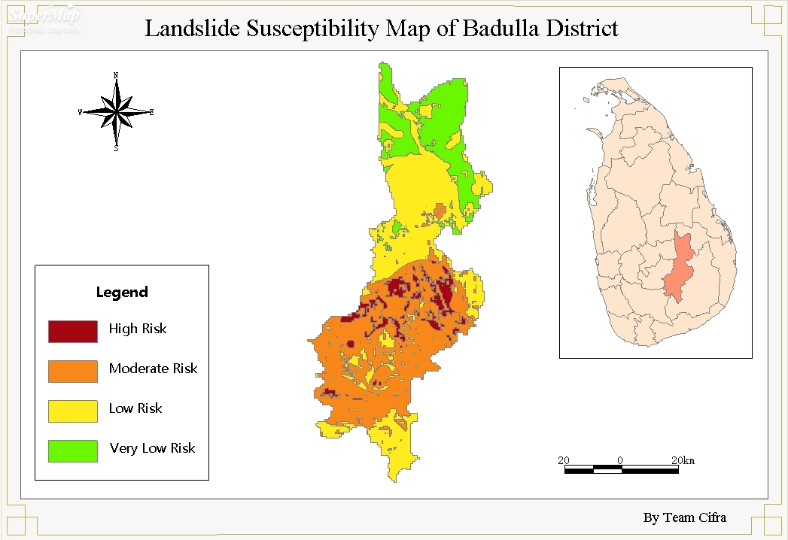
Landslide Susceptibility Map
High Risk Area = 159.767 km² (6%)
Moderate Risk Area = 1060.939km² (40%)
Low Risk Area = 987.539 km² (34%)
Very Low Risk Area = 451.913 km² (17%)

Slide 18
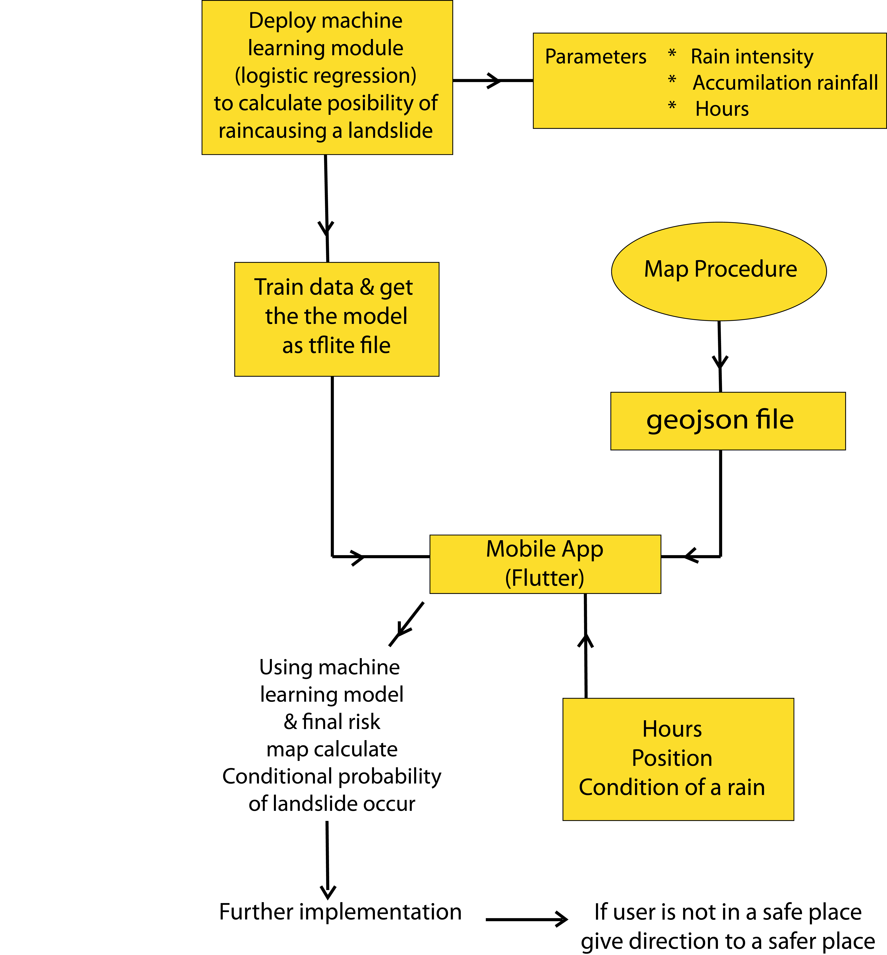
Methodology(Mobile Applications)

Slide 19
Data Collection
Used Applications Data Processing
Rainfall data
Climate Data Org
Landslide inventory data
NASA global landslide inventory
Lithology data
ORR & Associates
Distance to stream data
DEM
Land use data
Google Earth
Curvature/Slope/Aspect data
DEM
Arc GIS 10.8
QGIS
Geo Mapper
SuperMap
ERDAS Imagine
Used Applications for mobile app development
Machine learning model
-python (Google colabs)
Mobile app
-Flutter (Android studio)

Slide 20
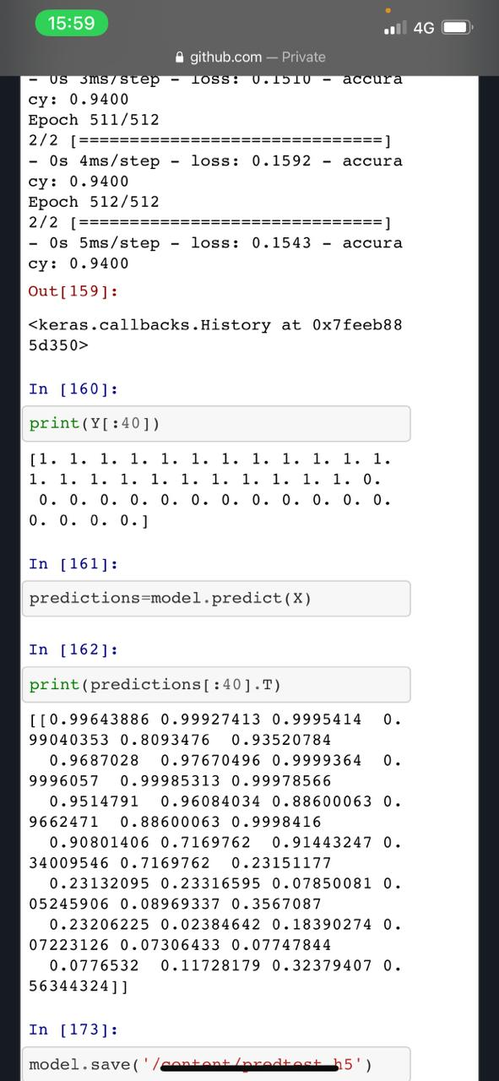
Machine Learning Module

Slide 21


Slide 22
Potential Considerations
To address this challenge, you could take into account the geology, the historical databases of landslides in the world, the elevation and surface information of the territory, the current land use, demographics, and other variables that you consider helpful in your methodology. Included variables could be processed under a model that allows the method to be standardized and replicable in different municipalities. ✅
Remember that incorporating data capture by the community will considerably enrich your analysis of both detection and prediction of risks. ✅
It is critical to present information in a straightforward, intuitive, and easy way for communities and local governments. ✅
Your tool should have a graphical interface that allows communities and local governments to view, interpret, include local information, and analyze decision-making results. ✅
Develop a prototype that is scalable but also operable at a low cost. ✅
Develop machine learning training data sets to predict landslides so that other researchers can easily incorporate training data into their processes. ✅
Create a code repository for your project so other people can review and take advantage of your efforts. ✅
Potential keywords your can search include: world, soil, information ✅

Slide 23
Further Implementations
Give directions to a safer location after creating a GIS network map of low risk areas & connect them with our mobile application.
Display data regarding past hazard scenarios which enables users to be aware of the seriousness of the situation.
Enable the users to report a hazard through our application which can be used in future implementations.
Automatically notify the user about risk level

Slide 24


Slide 25


Thank You
Team Cifra
Cifra.solutions.geo@gmail.com

